Slide 1
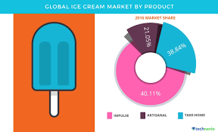
Title:
Ice cream revenue prediction

Slide 2
Name:allanki Harshini hallticket number:2203a52134
Trainer:
MR.D.RAMESH
ASST.PROFESSOR
CSE(AIML)

Slide 3
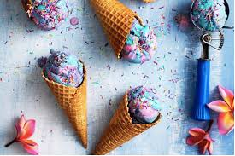
PROBLEM STATEMENT:
The problem statement for an icecream revenue dataset typically involves predicting revenue of selling ice-cream based on temperature

Slide 4
introduction
Ice cream revenue encompasses the income generated by the sale of ice cream and related products, including toppings, specialty items, beverages, and seasonal offerings in ice cream parlors and shops. This revenue can also include earnings from online and delivery services, event catering, franchising, and retail sales in grocery stores.
To calculate the actual profit, businesses deduct costs and expenses, such as ingredient expenses, labor, rent, utilities, and marketing expenditures. The ice cream industry often thrives on product innovation, effective marketing, and exceptional customer service to attract and retain a loyal customer base, especially during peak seasons when demand for cold treats is high.

Slide 5
ATTRIBUTE INFORMATION:
Location: The specific branch or location of the ice cream parlor.
Total Revenue: The total income earned by the ice cream parlor on the given date.
Ice Cream Sales: Revenue generated from selling various ice cream products.
Toppings Revenue: Income from selling ice cream toppings and extras.
Specialty Items Revenue: Revenue from specialty items like sundaes and ice cream cakes.
Beverages Revenue: Income generated from selling beverages like milkshakes.
Promotions and Discounts: Revenue impact of any applied promotions or discounts.
Seasonal Sales: Revenue attributed to seasonal ice cream flavors and promotions.
Online and Delivery Revenue: Income from online orders and delivery services.
Event Catering Revenue: Revenue from providing ice cream catering services.
Franchise Fees: Earnings from franchising or licensing the brand.
Retail Sales Revenue: Income from selling ice cream products in retail stores.
Operating Costs: Total operational expenses incurred on the recorded date.
Profit: Net profit calculated as Total Revenue minus Operating Costs.
Weather Data: Weather-related attributes that may affect ice cream sales.

Slide 6
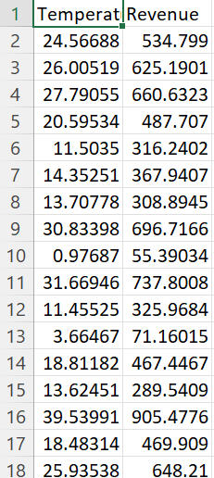
DATA SET:

Slide 7
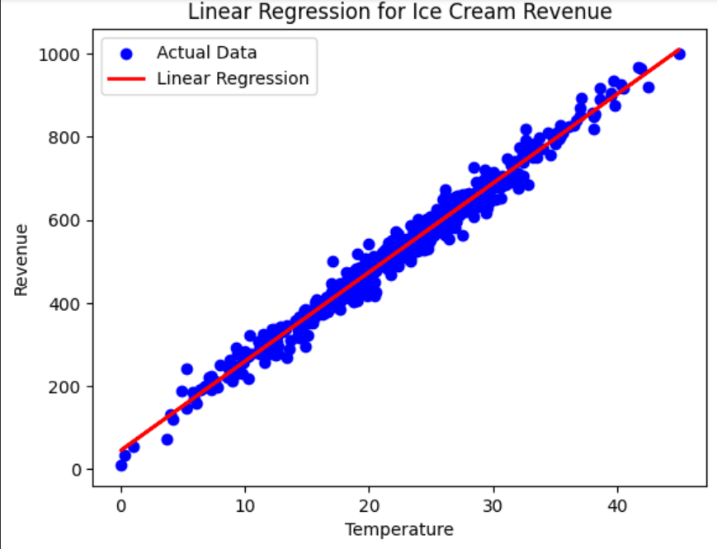
LINEAR REGRESSION
Linear regression is a statistical method used to model the relationship between two variables by fitting a linear equation to the observed data. It is commonly used in data analysis to identify trends and patterns in the data, and to make predictions based on those trends

Slide 8
Those trends. For example, let's say you are analyzing the relationship between a person's age and their income. You could use linear regression to determine if there is a correlation between these two variables and to predict someone's income based on their age. The equation for a simple linear regression model would be: Income = b0 + b1 * Age, where b0 is the intercept and b1 is the slope of the line.There are many different types of linear regression, including simple linear regression, multiple linear regression, and polynomial regression. Each type is appropriate to use depending on the nature of the data and the research question being asked. Overall, linear regression is a powerful tool for analyzing data and making predictions. By understanding this concept, you can gain valuable insights into the relationships between variables and make informed decisions based on that knowledge

Slide 9
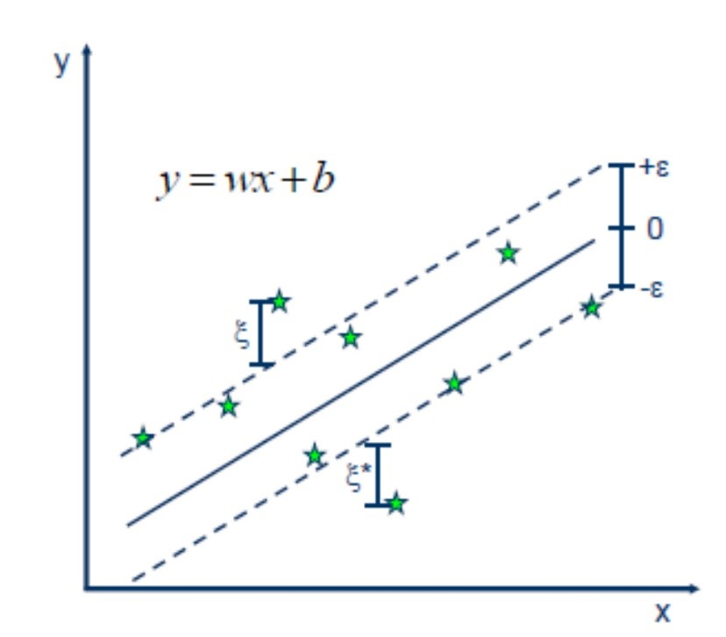
SVM(SUPPORT VECTOR MACHINE):
Support Vector Machine (SVM) is a powerful machine learning algorithm used for linear or nonlinear classification, regression, and even outlier detection tasks. SVMs can be used for a variety of tasks, such as text classification, image classification, spam detection, handwriting identification, gene expression analysis, face detection, and anomaly detection. SVMs are adaptable and efficient in a variety of applications because they can manage high-dimensional data and nonlinear relationships

Slide 10
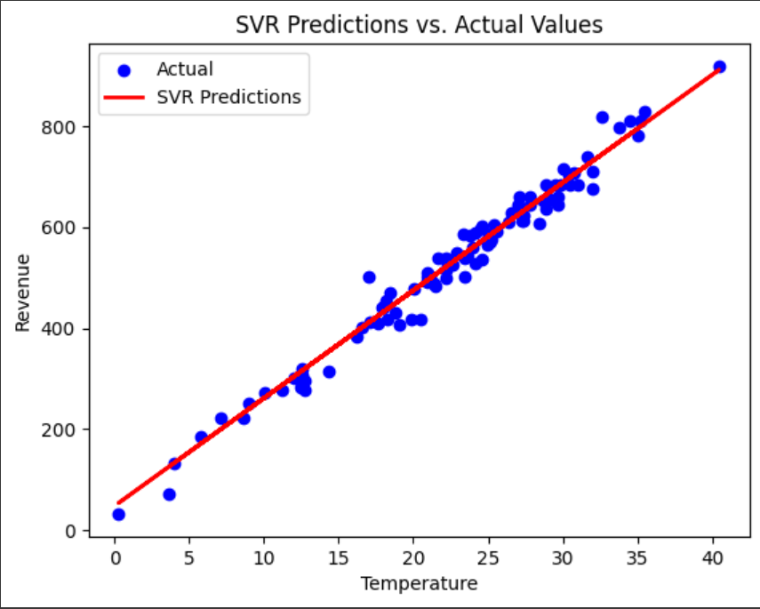
Svr graph:

Slide 11
Ridge regression:
Ridge regression is a regularization technique in linear regression. It addresses multicollinearity and overfitting by adding a penalty term (\( \lambda \) or alpha) to the regression's objective function. This term discourages large coefficient values, preventing the model from relying too heavily on any specific predictor variable.
By shrinking coefficients, ridge regression improves the model's stability and generalizability, especially in datasets with correlated predictors or high dimensionality. It strikes a balance between bias and variance, enhancing the model's performance and making it more robust. The optimal \( \lambda \) value is crucial and is often selected using methods like cross-validation.

Slide 12
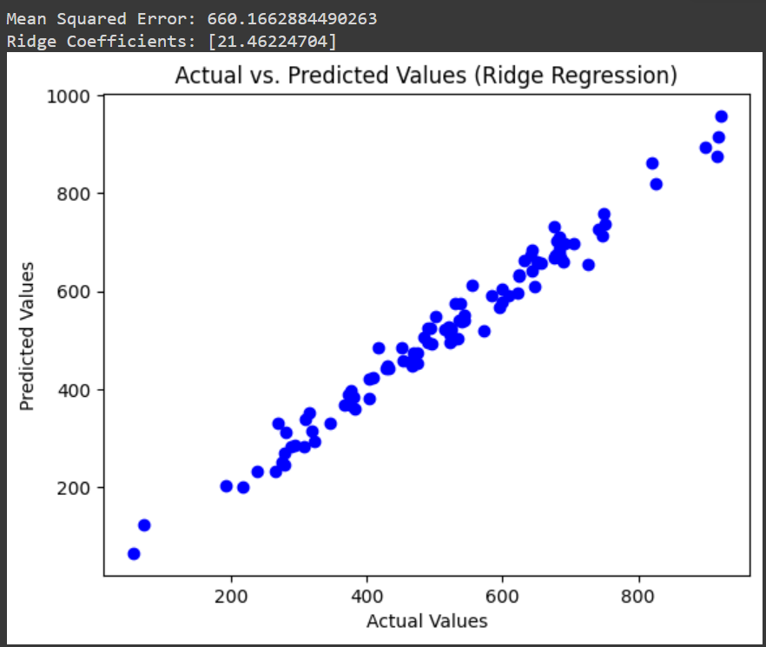
Graph related to ridge regression:

Slide 13
Lasso regression:
Lasso regression is a regularization technique. It is used over regression methods for a more accurate prediction. This model uses shrinkage. Shrinkage is where data values are shrunk towards a central point as the mean. The lasso procedure encourages simple, sparse models (i.e. models with fewer parameters).

Slide 14
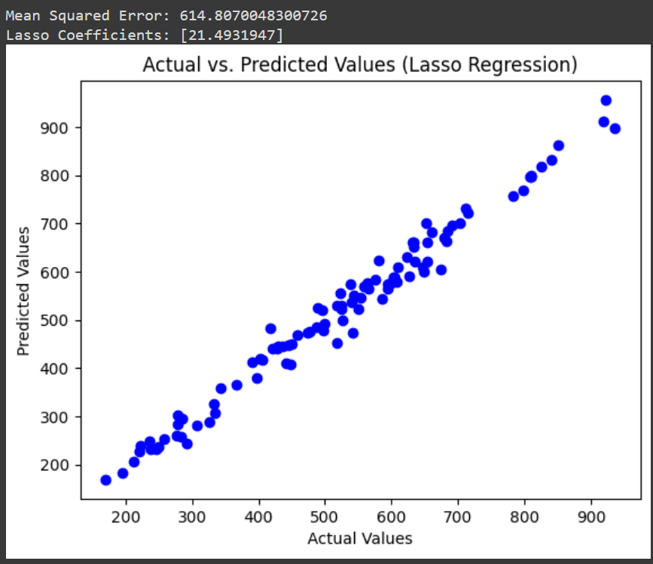
Graph related to lasso regression:

Slide 15
K-nearest neighbors:
K-Nearest Neighbors (KNN) is a machine learning algorithm used for both classification and regression tasks. It makes predictions based on the majority class or average value of the K-nearest data points in a feature space. KNN works by measuring distances between data points and selecting the K-nearest neighbors to make predictions. The choice of K can impact the algorithm’s performance, and it is a simple but often effective approach for various tasks.

Slide 16
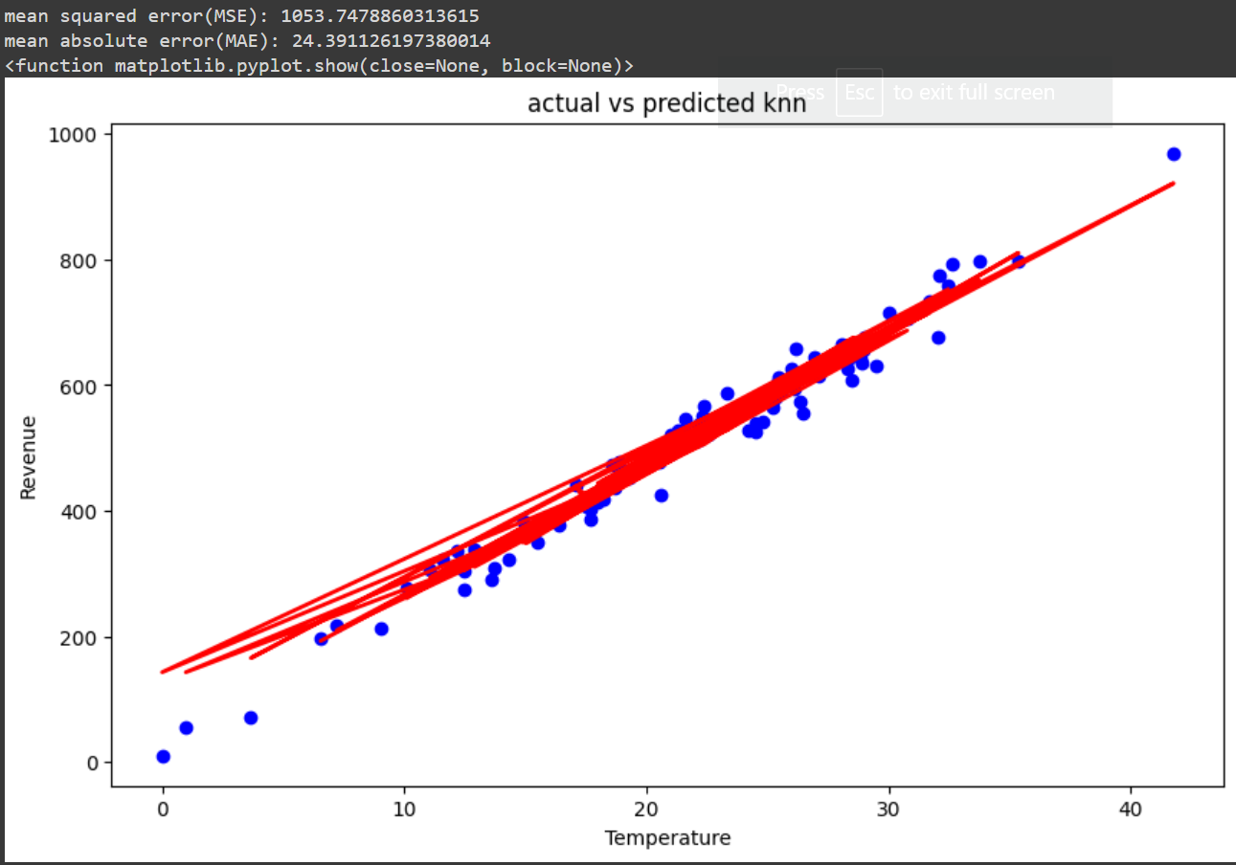
Graph of knn:

Slide 17
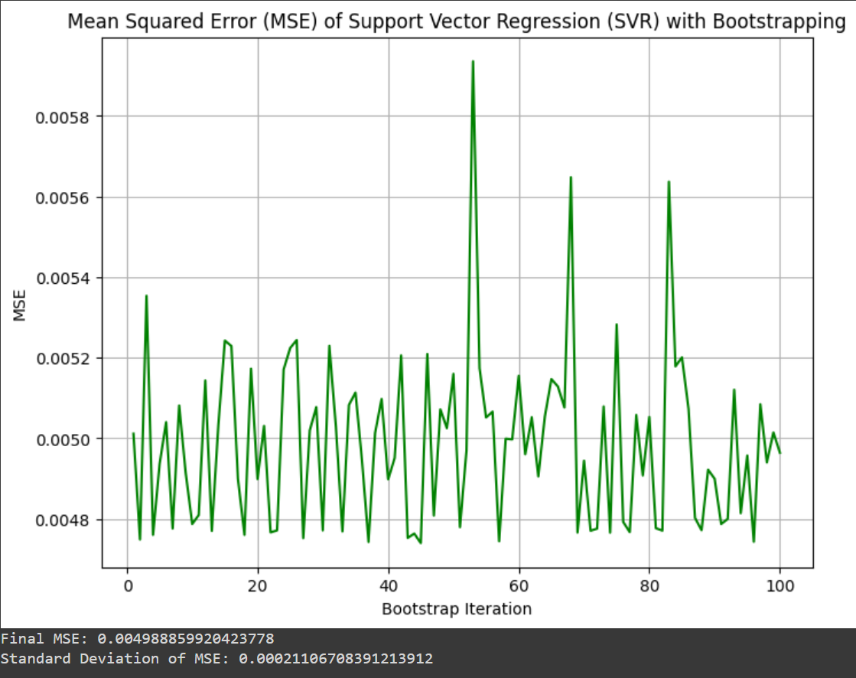
Bootstrapping:
Bootstrapping is a statistical technique where data is resampled with replacement to estimate the distribution of a statistic. It allows for making inferences about population parameters without assuming a specific data distribution.

Slide 18
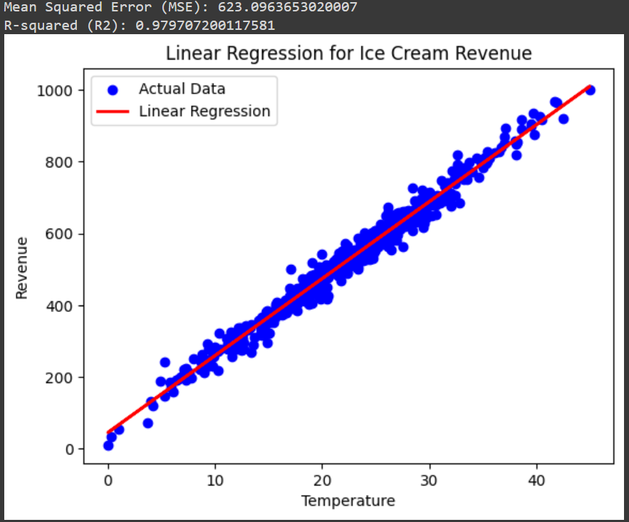
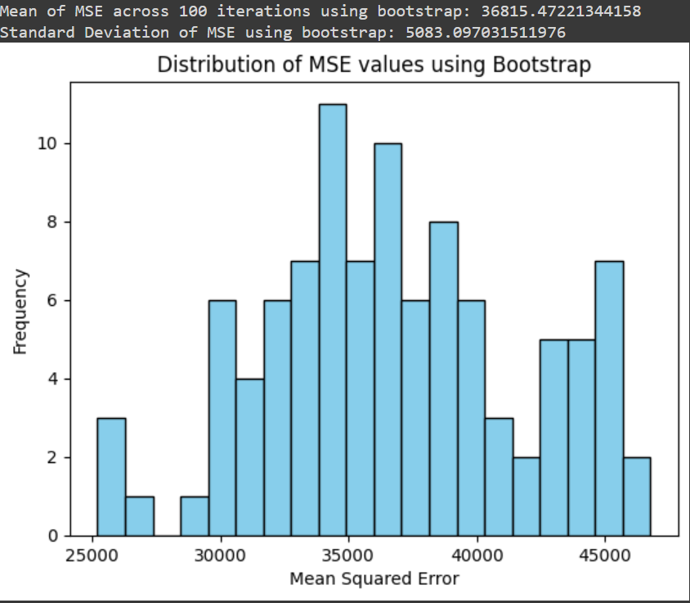

Slide 19
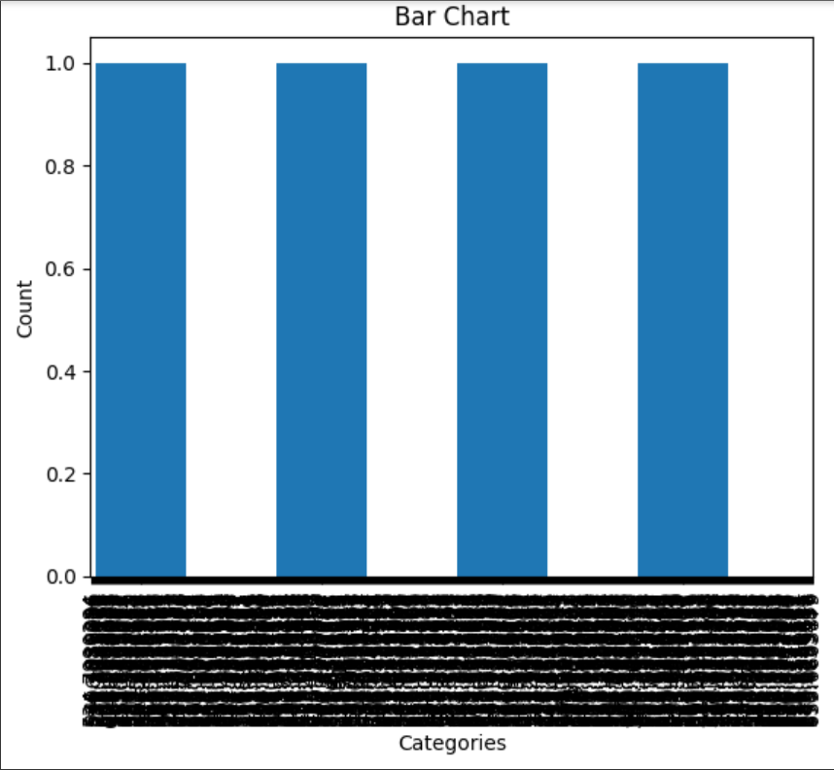
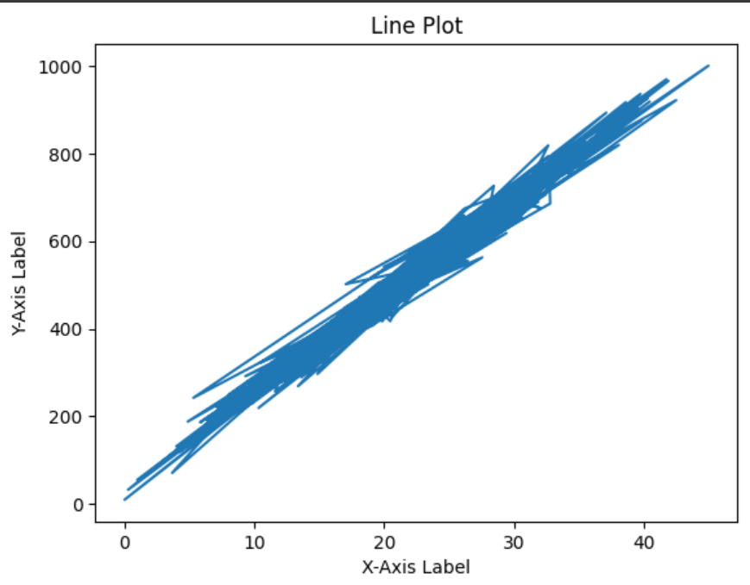
Graphs:

Slide 20
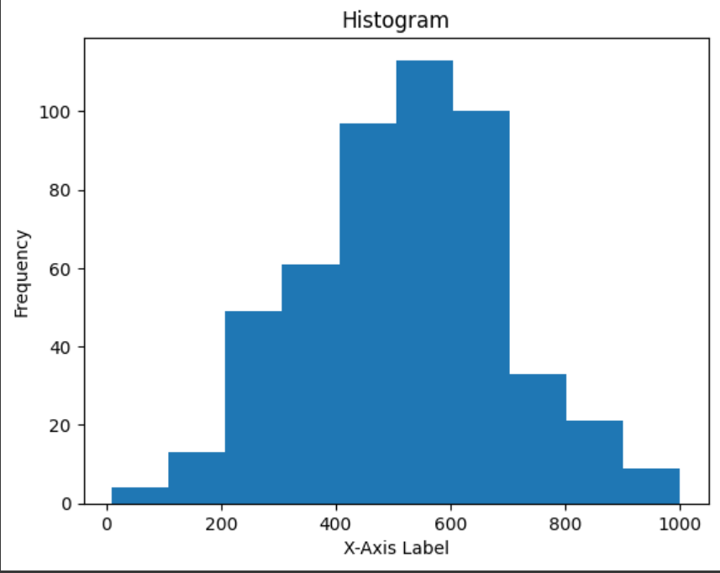
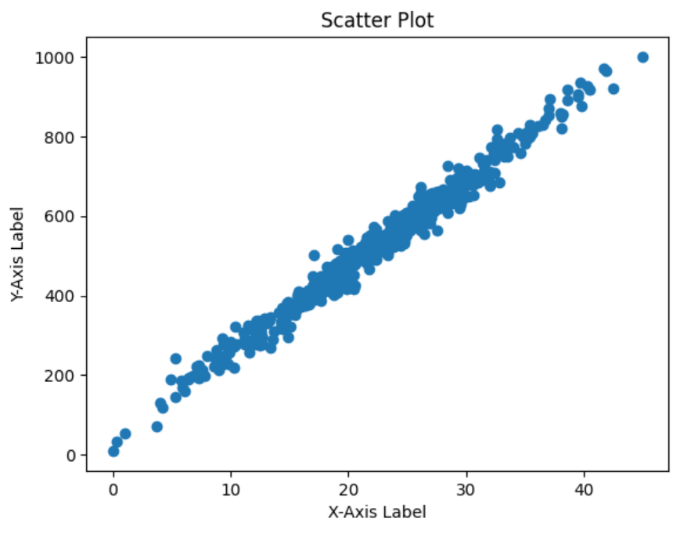

Slide 21
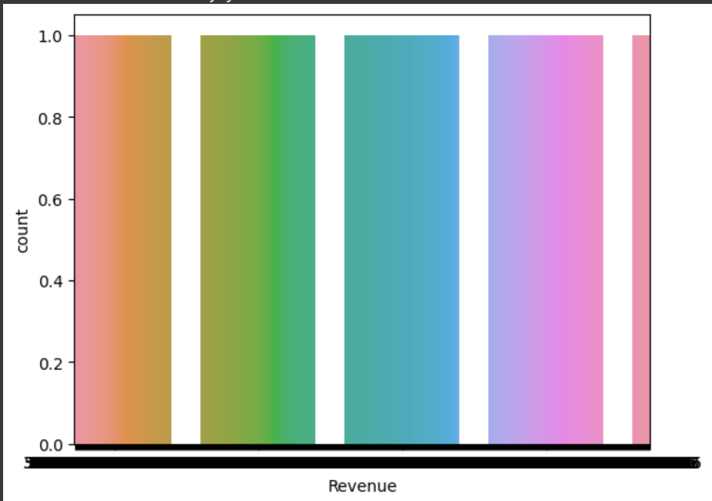
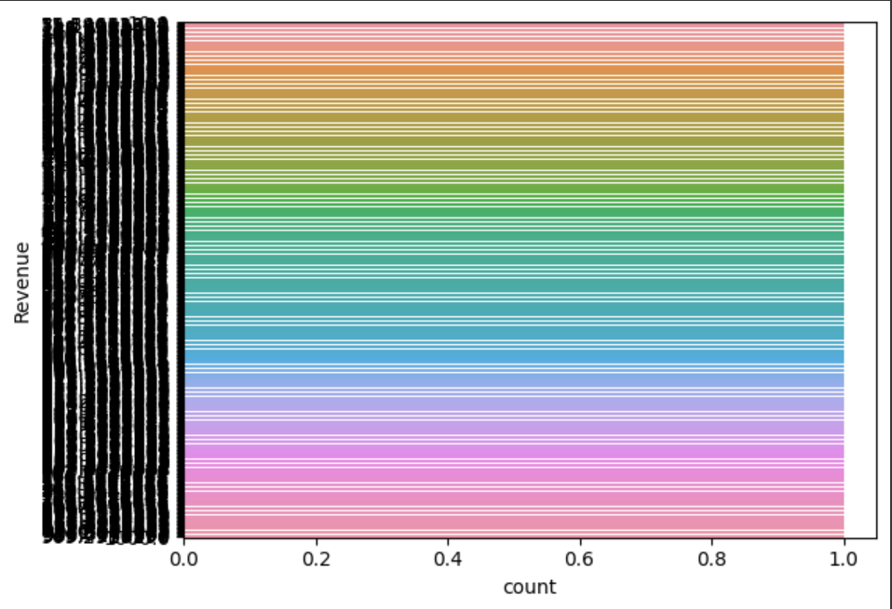

Slide 22
Conclusion:
Based on the analysis of the ice cream revenue dataset, it is evident that seasonal fluctuations strongly influence sales, with peak revenue occurring during the summer months, indicating the significant impact of weather conditions. Furthermore, demographic analysis revealed that certain customer segments, particularly families and young adults, contribute substantially to overall revenue.
The dataset also highlighted the popularity of specific ice cream flavors, with chocolate, vanilla, and strawberry consistently leading in sales. To further boost revenue, it is recommended to invest in targeted marketing campaigns during the off-peak seasons, expand the product line to include innovative flavors, and closely monitor weather forecasts to optimize inventory and staffing levels during periods of high demand, ultimately maximizing profitability.

Slide 23
Result:
LINEAR REGRESSION:0.979707200117581
SUPPORT VECTOR MACHINE:0.9770559582160986
RIDGE REGRESSION:
Mean Squared Error: 660.1662884490263
Ridge Coefficients: [21.46224704]
With bootstrapping:
Mean of MSE across 100 iterations: 624.2450770911487
Standard Deviation of MSE: 75.93575928455009
Average Ridge Coefficients: [21.44481208]

Slide 24
Result:
LASSO REGRESSION:
Mean Squared Error: 614.8070048300726
Lasso Coefficients: [21.4931947]
With bootstrapping:
Mean of MSE across 100 iterations for Lasso regression: 607.3448329087855
Standard Deviation of MSE for Lasso regression: 97.93337694285302
Average Lasso Coefficients: [21.44167142]
KNN:
Mean squared error(MSE): 1053.7478860313615
Mean absolute error(MAE): 24.391126197380014
With bootstrapping:
Mean of MSE across 100 iterations using bootstrap: 36815.47221344158
Standard Deviation of MSE using bootstrap: 5083.097031511976

Slide 25
Github link:
https://github.com/Harshini7A/ice-cream-revenue-prediction.git

Slide 26
THANK YOU

